Slide 1
Bootstrap Tables
廖向德

Slide 2
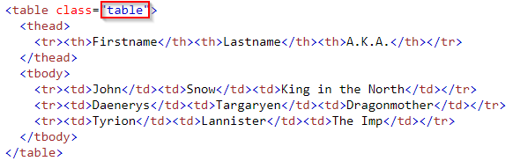
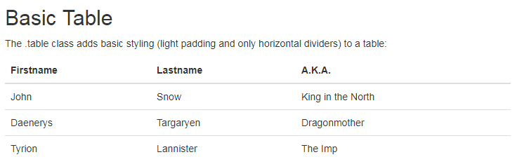
Basic Table
The .table class adds basic styling to a table
Notes:
<!DOCTYPE html>
<html lang="en">
<head>
<title>Bootstrap Example</title>
<meta charset="utf-8">
<meta name="viewport" content="width=device-width, initial-scale=1">
<link rel="stylesheet" href="https://maxcdn.bootstrapcdn.com/bootstrap/3.3.7/css/bootstrap.min.css">
<script src="https://ajax.googleapis.com/ajax/libs/jquery/3.2.1/jquery.min.js"></script>
<script src="https://maxcdn.bootstrapcdn.com/bootstrap/3.3.7/js/bootstrap.min.js"></script>
</head>
<body>
<div class="container">
<h2>Basic Table</h2>
<p>The .table class adds basic styling (light padding and only horizontal dividers) to a table:</p>
<table class="table">
<thead>
<tr><th>Firstname</th><th>Lastname</th><th>A.K.A.</th></tr>
</thead>
<tbody>
<tr><td>John</td><td>Snow</td><td>King in the North</td></tr>
<tr><td>Daenerys</td><td>Targaryen</td><td>Dragonmother</td></tr>
<tr><td>Tyrion</td><td>Lannister</td><td>The Imp</td></tr>
</tbody>
</table>
</div>
</body>
</html>

Slide 3
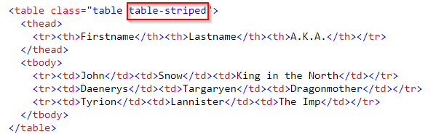
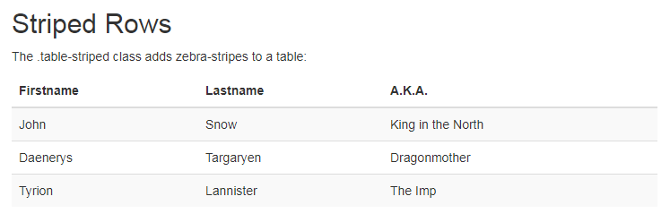
Striped Rows
The .table-striped class adds zebra-stripes to a table
Notes:
<!DOCTYPE html>
<html lang="en">
<head>
<title>Bootstrap Example</title>
<meta charset="utf-8">
<meta name="viewport" content="width=device-width, initial-scale=1">
<link rel="stylesheet" href="https://maxcdn.bootstrapcdn.com/bootstrap/3.3.7/css/bootstrap.min.css">
<script src="https://ajax.googleapis.com/ajax/libs/jquery/3.2.1/jquery.min.js"></script>
<script src="https://maxcdn.bootstrapcdn.com/bootstrap/3.3.7/js/bootstrap.min.js"></script>
</head>
<body>
<div class="container">
<h2>Striped Rows</h2>
<p>The .table-striped class adds zebra-stripes to a table:</p>
<table class="table table-striped">
<thead>
<tr><th>Firstname</th><th>Lastname</th><th>A.K.A.</th></tr>
</thead>
<tbody>
<tr><td>John</td><td>Snow</td><td>King in the North</td></tr>
<tr><td>Daenerys</td><td>Targaryen</td><td>Dragonmother</td></tr>
<tr><td>Tyrion</td><td>Lannister</td><td>The Imp</td></tr>
</tbody>
</table>
</div>
</body>
</html>

Slide 4
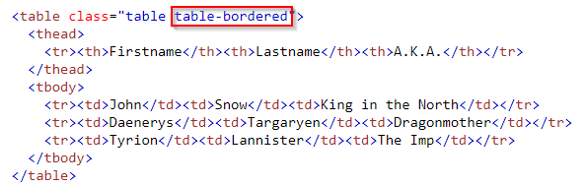
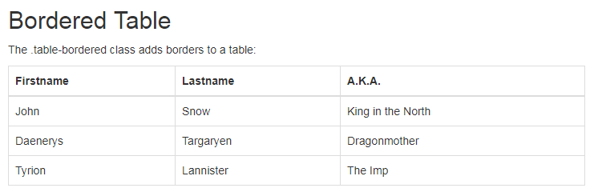
Bordered Table
The .table-bordered class adds borders on all sides of the table and cells
Notes:
<!DOCTYPE html>
<html lang="en">
<head>
<title>Bootstrap Example</title>
<meta charset="utf-8">
<meta name="viewport" content="width=device-width, initial-scale=1">
<link rel="stylesheet" href="https://maxcdn.bootstrapcdn.com/bootstrap/3.3.7/css/bootstrap.min.css">
<script src="https://ajax.googleapis.com/ajax/libs/jquery/3.2.1/jquery.min.js"></script>
<script src="https://maxcdn.bootstrapcdn.com/bootstrap/3.3.7/js/bootstrap.min.js"></script>
</head>
<body>
<div class="container">
<h2>Bordered Table</h2>
<p>The .table-bordered class adds borders to a table:</p>
<table class="table table-bordered">
<thead>
<tr><th>Firstname</th><th>Lastname</th><th>A.K.A.</th></tr>
</thead>
<tbody>
<tr><td>John</td><td>Snow</td><td>King in the North</td></tr>
<tr><td>Daenerys</td><td>Targaryen</td><td>Dragonmother</td></tr>
<tr><td>Tyrion</td><td>Lannister</td><td>The Imp</td></tr>
</tbody>
</table>
</div>
</body>
</html>

Slide 5
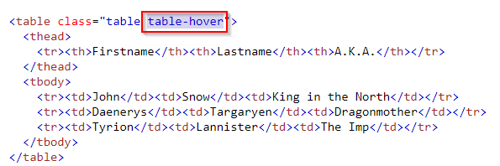
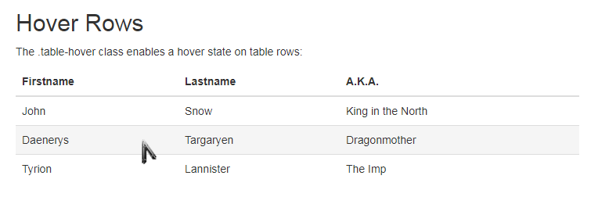
Hover Rows
The .table-hover class adds a hover effect (grey background color) on table rows
https://www.w3schools.com/code/tryit.asp?filename=FKCE75SZ2TPR
Notes:
<!DOCTYPE html>
<html lang="en">
<head>
<title>Bootstrap Example</title>
<meta charset="utf-8">
<meta name="viewport" content="width=device-width, initial-scale=1">
<link rel="stylesheet" href="https://maxcdn.bootstrapcdn.com/bootstrap/3.3.7/css/bootstrap.min.css">
<script src="https://ajax.googleapis.com/ajax/libs/jquery/3.2.1/jquery.min.js"></script>
<script src="https://maxcdn.bootstrapcdn.com/bootstrap/3.3.7/js/bootstrap.min.js"></script>
</head>
<body>
<div class="container">
<h2>Hover Rows</h2>
<p>The .table-hover class enables a hover state on table rows:</p>
<table class="table table-hover">
<thead>
<tr><th>Firstname</th><th>Lastname</th><th>A.K.A.</th></tr>
</thead>
<tbody>
<tr><td>John</td><td>Snow</td><td>King in the North</td></tr>
<tr><td>Daenerys</td><td>Targaryen</td><td>Dragonmother</td></tr>
<tr><td>Tyrion</td><td>Lannister</td><td>The Imp</td></tr>
</tbody>
</table>
</div>
</body>
</html>

Slide 6
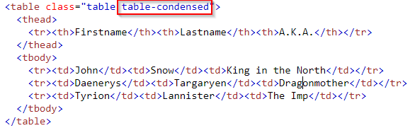
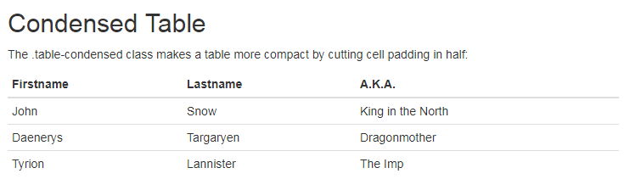
Condensed Table
https://www.w3schools.com/code/tryit.asp?filename=FKCEC5TSBEGN
Notes:
<!DOCTYPE html>
<html lang="en">
<head>
<title>Bootstrap Example</title>
<meta charset="utf-8">
<meta name="viewport" content="width=device-width, initial-scale=1">
<link rel="stylesheet" href="https://maxcdn.bootstrapcdn.com/bootstrap/3.3.7/css/bootstrap.min.css">
<script src="https://ajax.googleapis.com/ajax/libs/jquery/3.2.1/jquery.min.js"></script>
<script src="https://maxcdn.bootstrapcdn.com/bootstrap/3.3.7/js/bootstrap.min.js"></script>
</head>
<body>
<div class="container">
<h2>Condensed Table</h2>
<p>The .table-condensed class makes a table more compact by cutting cell padding in half:</p>
<table class="table table-condensed">
<thead>
<tr><th>Firstname</th><th>Lastname</th><th>A.K.A.</th></tr>
</thead>
<tbody>
<tr><td>John</td><td>Snow</td><td>King in the North</td></tr>
<tr><td>Daenerys</td><td>Targaryen</td><td>Dragonmother</td></tr>
<tr><td>Tyrion</td><td>Lannister</td><td>The Imp</td></tr>
</tbody>
</table>
</div>
</body>
</html>

Slide 7
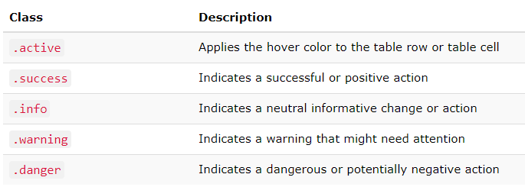
Contextual Classes
Contextual classes can be used to color table rows (<tr>) or table cells (<th>, <td>)
https://www.w3schools.com/bootstrap/tryit.asp?filename=trybs_table_contextual&stacked=h
Notes:
<!DOCTYPE html>
<html lang="en">
<head>
<title>Bootstrap Example</title>
<meta charset="utf-8">
<meta name="viewport" content="width=device-width, initial-scale=1">
<link rel="stylesheet" href="https://maxcdn.bootstrapcdn.com/bootstrap/3.3.7/css/bootstrap.min.css">
<script src="https://ajax.googleapis.com/ajax/libs/jquery/3.2.1/jquery.min.js"></script>
<script src="https://maxcdn.bootstrapcdn.com/bootstrap/3.3.7/js/bootstrap.min.js"></script>
</head>
<body>
<div class="container">
<h2>Contextual Classes</h2>
<p>Contextual classes can be used to color table rows or table cells. The classes that can be used are: .active, .success, .info, .warning, and .danger.</p>
<table class="table">
<thead>
<tr>
<th>Firstname</th>
<th>Lastname</th>
<th>Email</th>
</tr>
</thead>
<tbody>
<tr>
<td>Default</td>
<td>Defaultson</td>
<td>def@somemail.com</td>
</tr>
<tr class="success">
<td>Success</td>
<td>Doe</td>
<td>john@example.com</td>
</tr>
<tr class="danger">
<td>Danger</td>
<td>Moe</td>
<td>mary@example.com</td>
</tr>
<tr class="info">
<td>Info</td>
<td>Dooley</td>
<td>july@example.com</td>
</tr>
<tr class="warning">
<td>Warning</td>
<td>Refs</td>
<td>bo@example.com</td>
</tr>
<tr class="active">
<td>Active</td>
<td>Activeson</td>
<td>act@example.com</td>
</tr>
</tbody>
</table>
</div>
</body>
</html>

Slide 8
Responsive Tables
The .table-responsive class creates a responsive table. The table will then scroll horizontally on small devices (under 768px). When viewing on anything larger than 768px wide, there is no difference.
Attention: To make any table responsive just place the table inside a <div> element and apply the class .table-responsive on it
https://www.w3schools.com/bootstrap/tryit.asp?filename=trybs_ref_table-responsive&stacked=h
Notes:
<!DOCTYPE html>
<html>
<head>
<meta name="viewport" content="width=device-width, initial-scale=1">
<link rel="stylesheet" href="https://maxcdn.bootstrapcdn.com/bootstrap/3.3.7/css/bootstrap.min.css">
<script src="https://ajax.googleapis.com/ajax/libs/jquery/3.2.1/jquery.min.js"></script>
<script src="https://maxcdn.bootstrapcdn.com/bootstrap/3.3.7/js/bootstrap.min.js"></script>
</head>
<body>
<div class="container">
<h2>Table</h2>
<p>The .table-responsive class creates a responsive table which will scroll horizontally on small devices (under 768px). When viewing on anything larger than 768px wide, there is no difference:</p>
<div class="table-responsive">
<table class="table">
<thead>
<tr>
<th>#</th>
<th>Firstname</th>
<th>Lastname</th>
<th>Age</th>
<th>City</th>
<th>Country</th>
</tr>
</thead>
<tbody>
<tr>
<td>1</td>
<td>Anna</td>
<td>Pitt</td>
<td>35</td>
<td>New York</td>
<td>USA</td>
</tr>
</tbody>
</table>
</div>
</div>
</body>
</html>

Slide 9
Test Yourself
Exercise 1 Use a Bootstrap class to style the table properly (with padding and horizontal dividers)
Exercise 2 Add zebra-stripes to the table
Exercise 3 Add borders on all sides of the table and cells
Exercise 4 Enable a hover state on table rows
Exercise 5 Make the table more compact by cutting cell padding in half
Exercise 6 Use contextual classes

